Slide 1
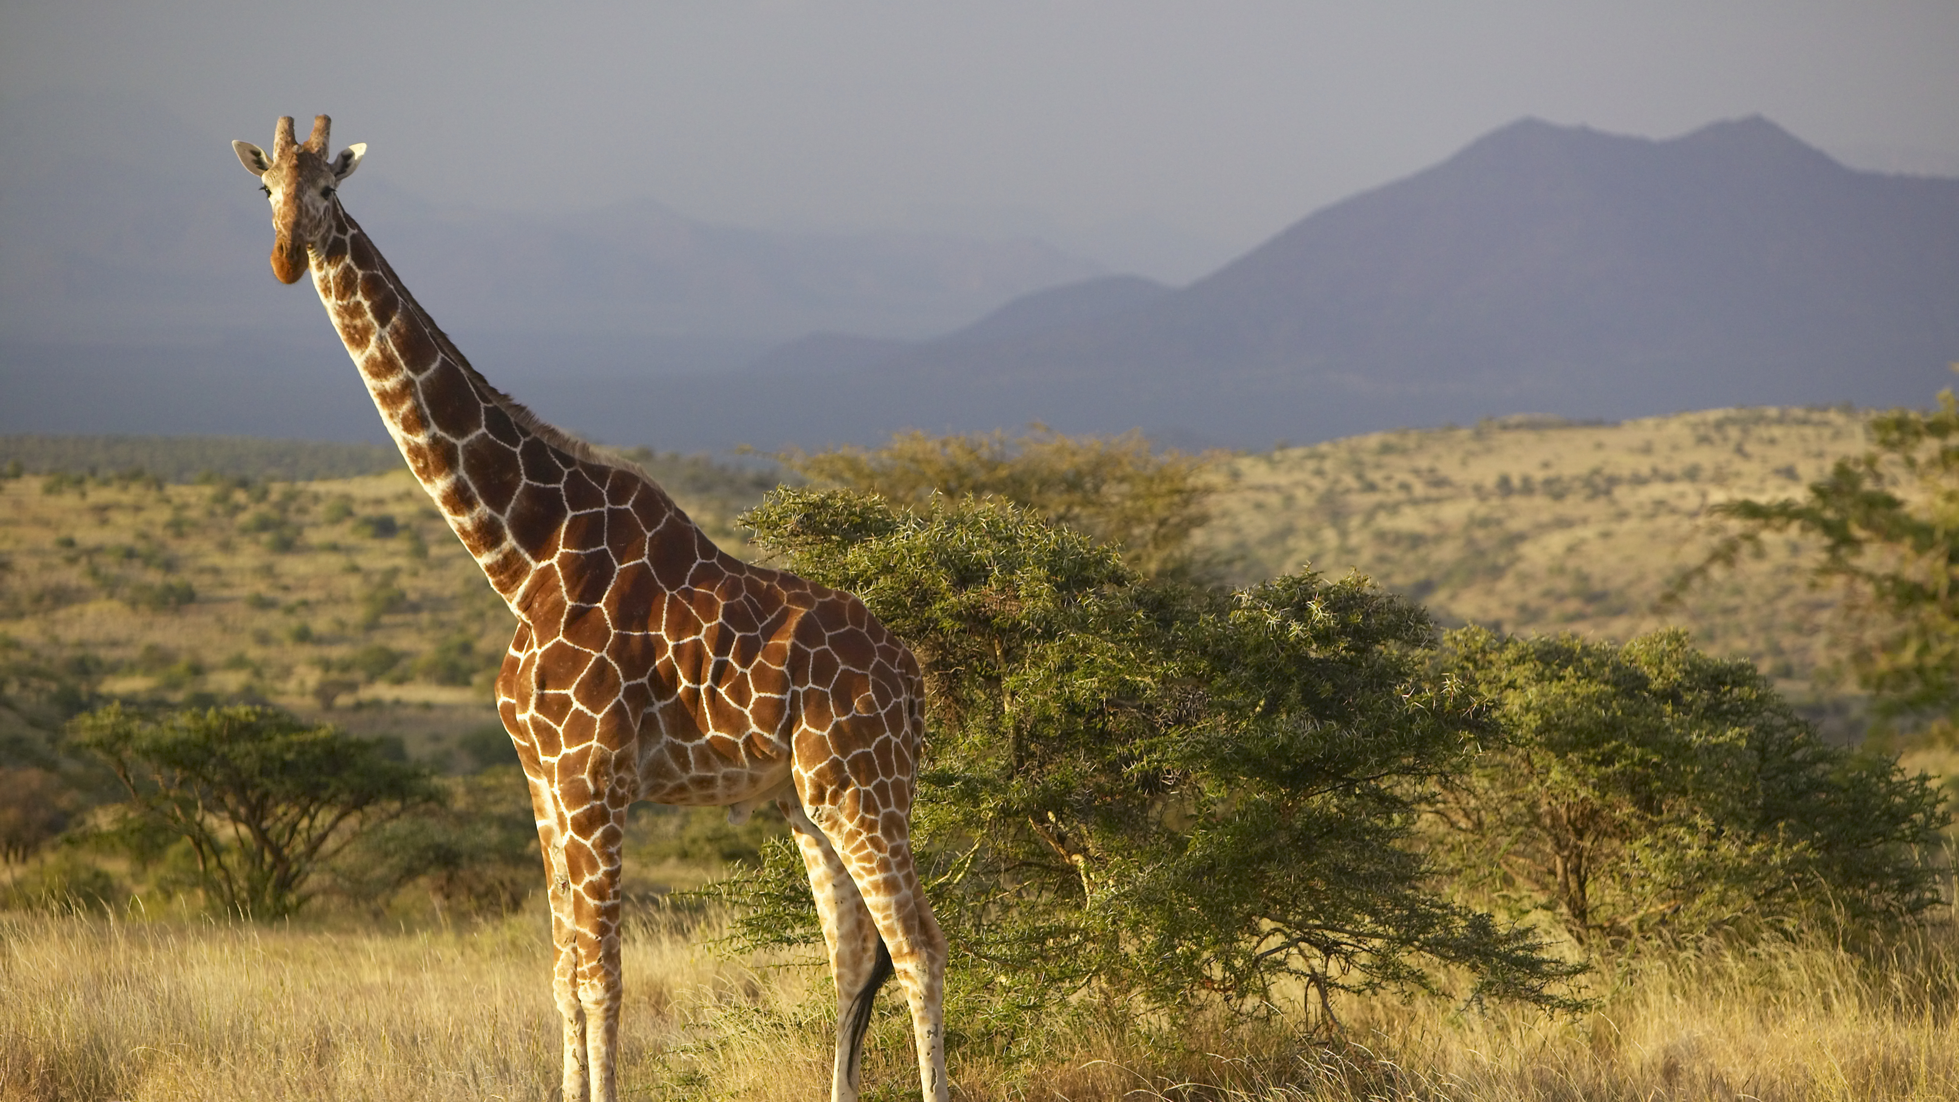
Exploring data
Christina Simbenga
Module 2 Lesson 9 HO

Slide 2
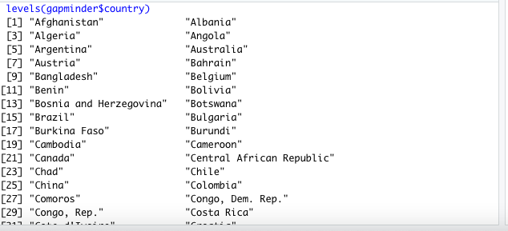
View the data

Slide 3
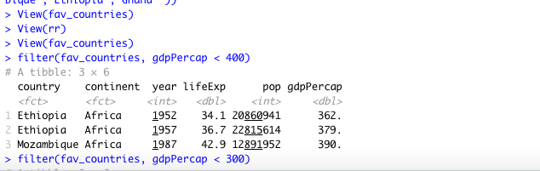
LOWEST GDP in 1952 and 2007
Was Ethiopia both times
filter(fav_countries, gdpPercap < 400)
filter(fav_countries, gdpPercap < 379)
# Ethiopia seems to have the lowest GDP in 1952
# Lowest GDP in 2007
filter(fav_countries, year== 2007)
# Ethiopia had the lowest GDP in 2007 as well

Slide 4
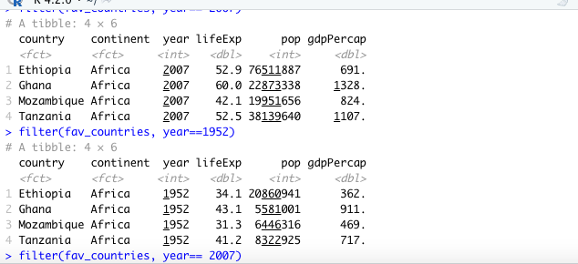
THE HIGHEST GDP
It was Ghana both times
# highest GDP
filter(fav_countries, year==1952)
# highest GDP in 1952 was Ghana
filter(fav_countries, year== 2007)
# highest GDP in 2007 is Ghana as well

Slide 5
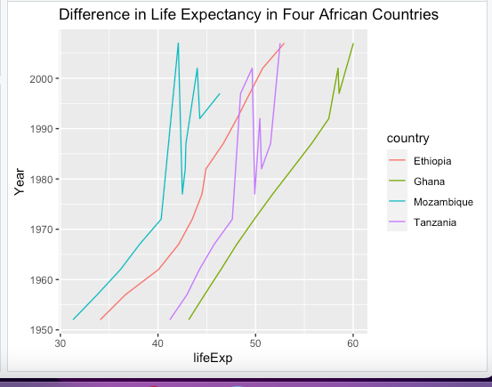
BAR GRAPH COMPARISON
# In places such as Ethiopia and Ghana as the years go on the longer people live
# for places like Mozambique and Tanzania it varies how long people live
ggplot(fav_countries) + geom_line(aes(x= lifeExp, y= year, color= country)) +
ylab("Year") + ggtitle("Difference in Life Expectancy in Four African Countries")

Slide 6

MEDIAN
# life expectancy for the whole data
life_Exp <- gapminder %>% group_by(year) %>% summarise(life_Exp.med = median(lifeExp))
fav_medians <- fav_countries %>% filter(year== 1952) %>% group_by(year) %>% summarise(life_Exp.med = median(lifeExp))
fav_medians <- fav_countries %>% filter(year== 2007) %>% group_by(year) %>% summarise(life_Exp.med = median(lifeExp))
# none of the countries are above the median life expectancy for the entire data frame

